Slide 1



Changing Authentication Method to Microsoft Authentication APP:
For Access to University Computing Resources Online
Created by: Dr Andrew Tappenden - Sept 2020

Slide 2
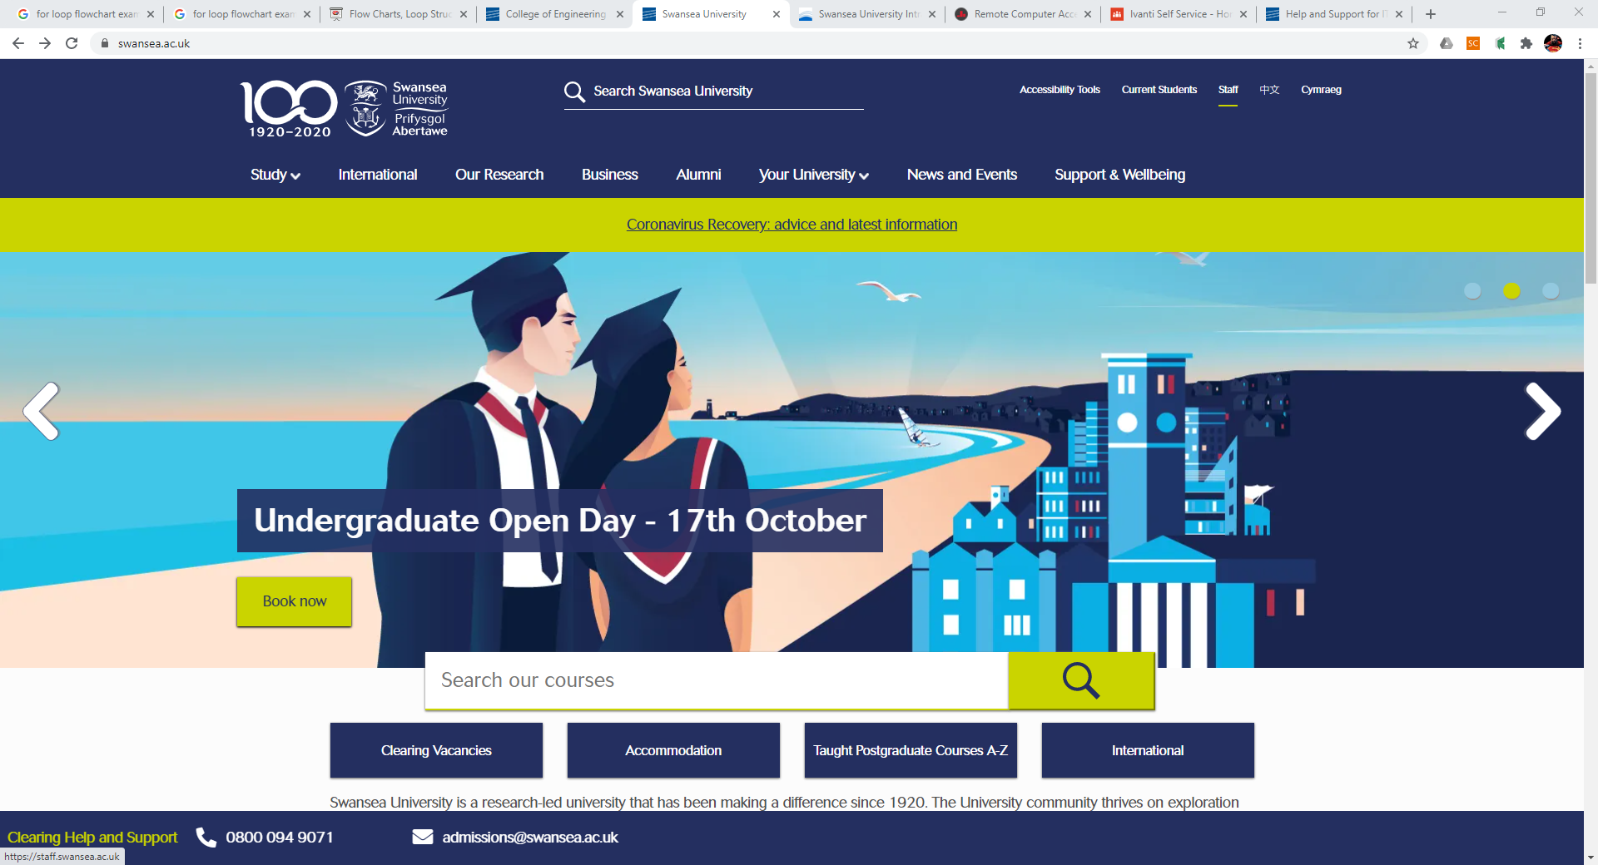

Slide 3
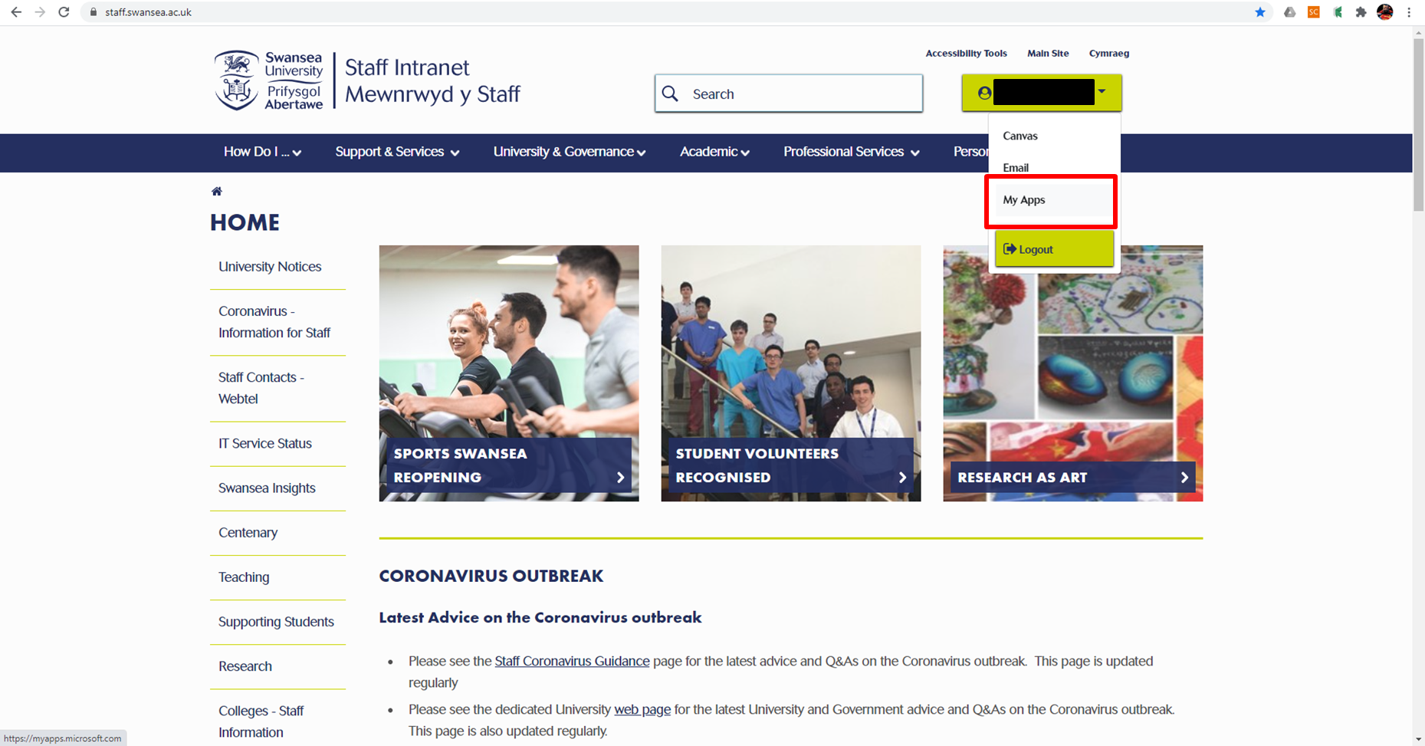

Slide 4
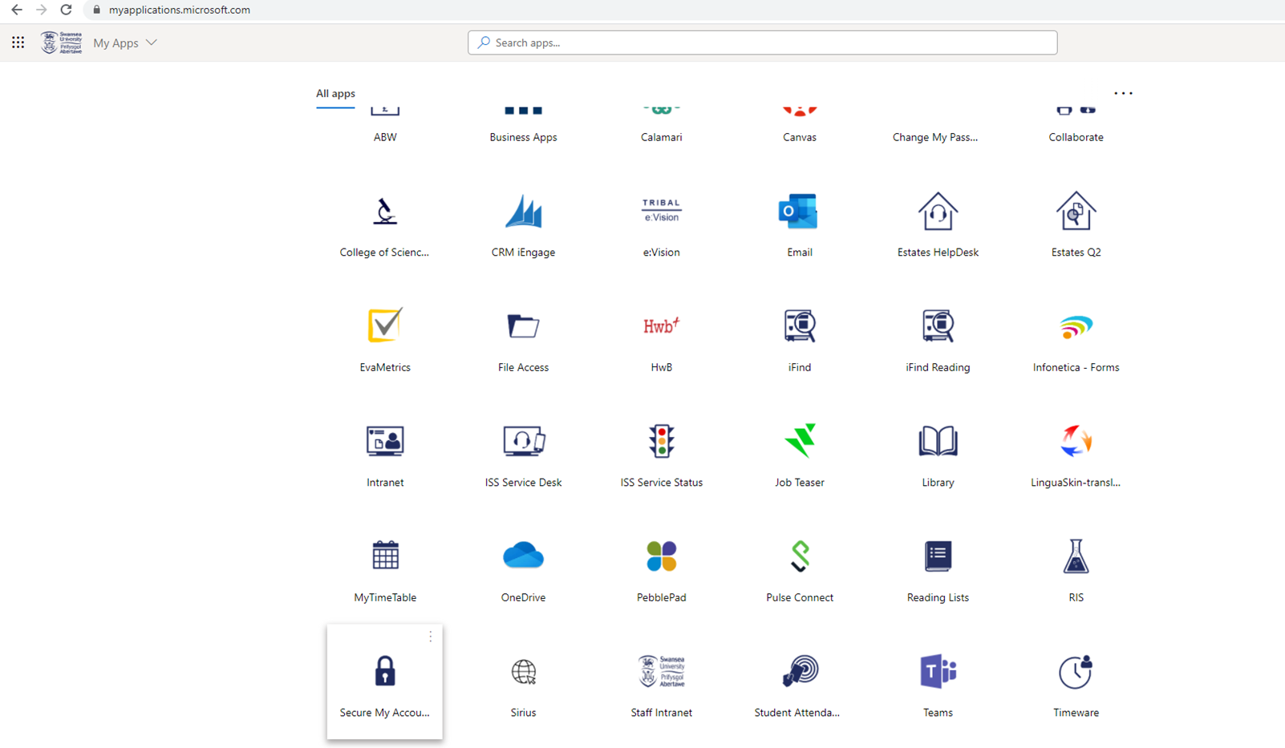

Slide 5
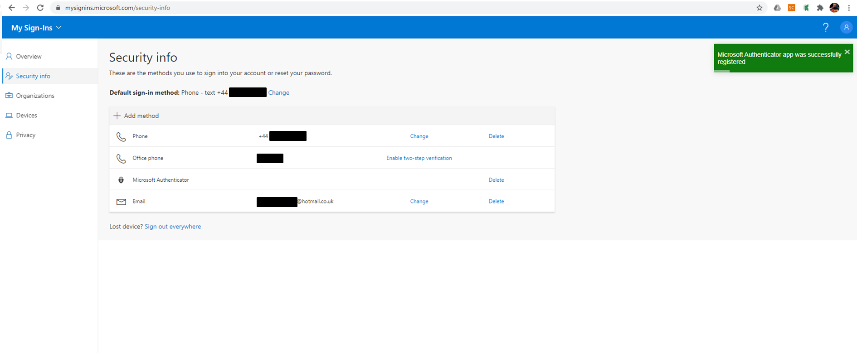

Slide 7
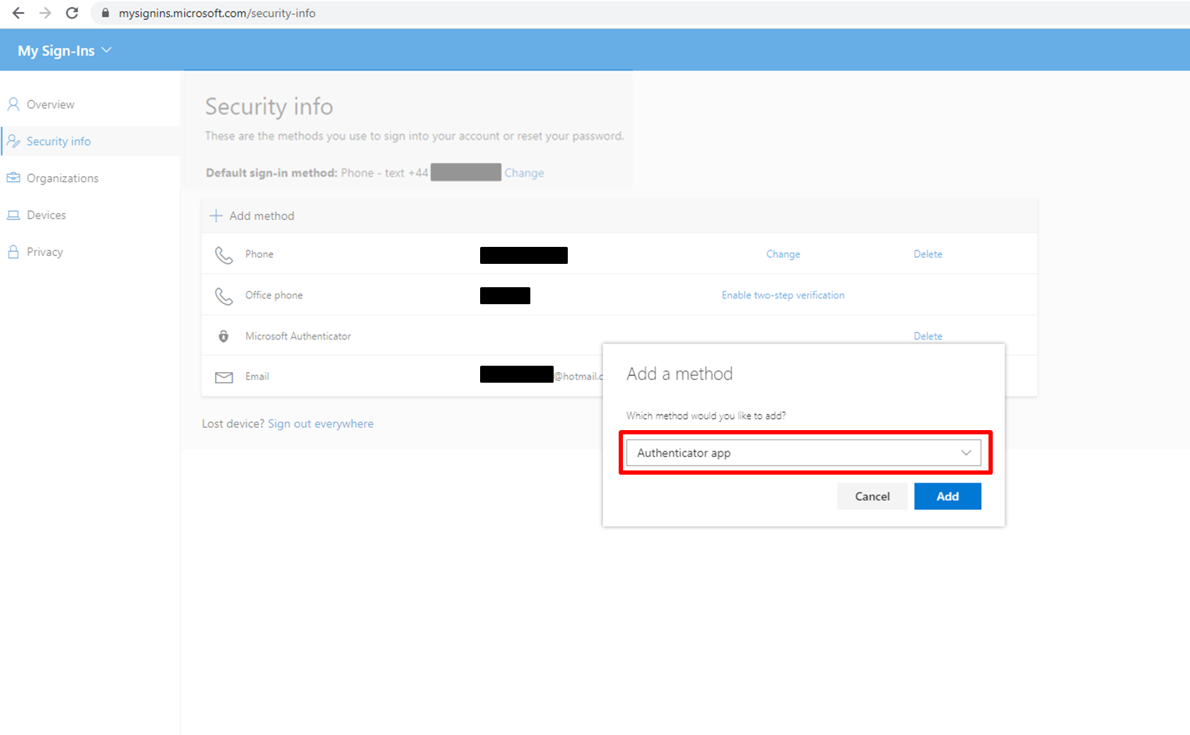

Slide 8
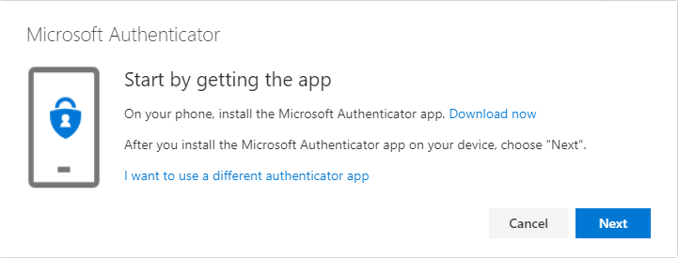
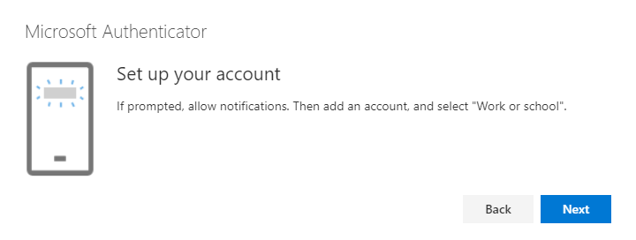
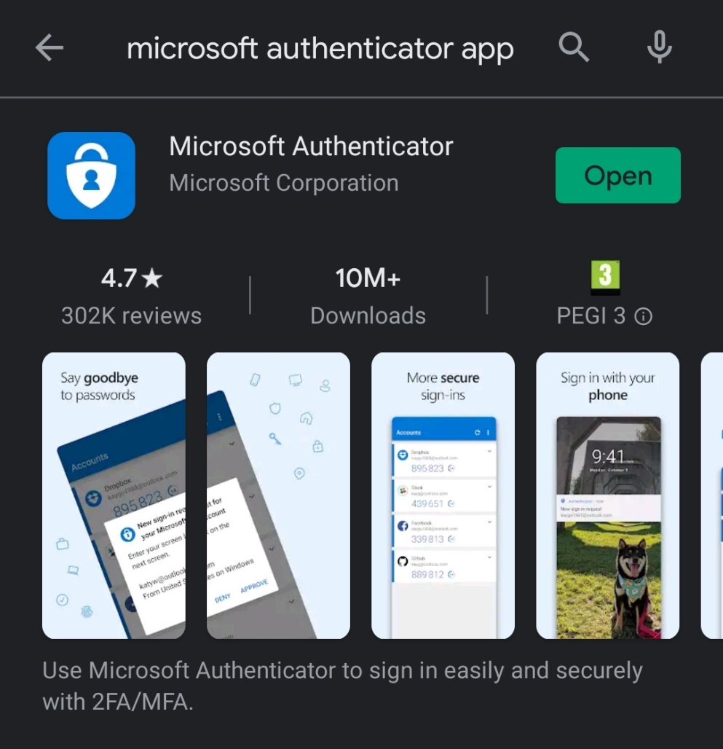
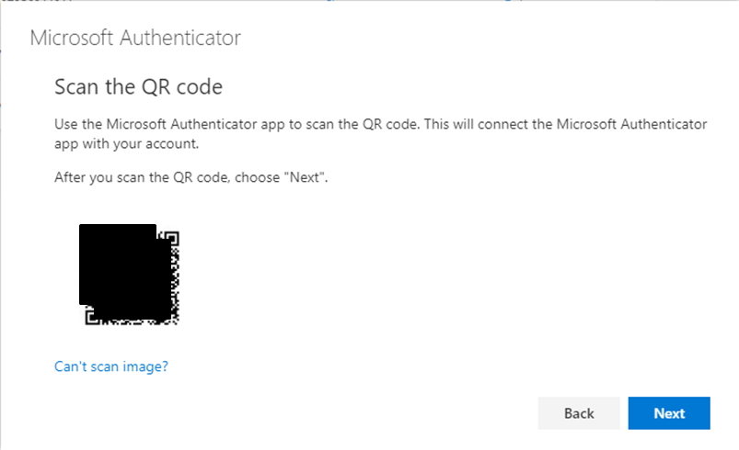
Notifications and instructions
Step 01
Step 03
Step 02
Step 04

Slide 9
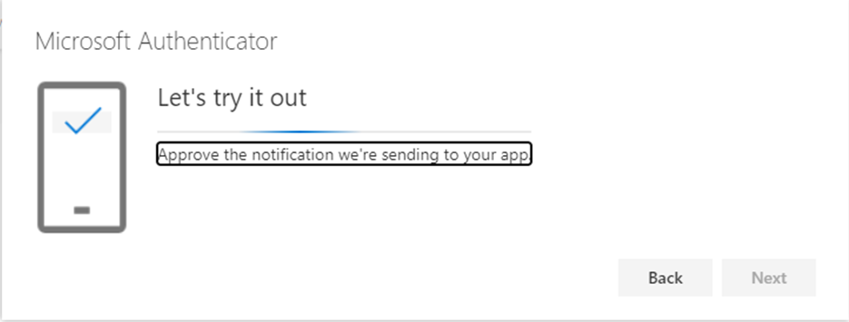
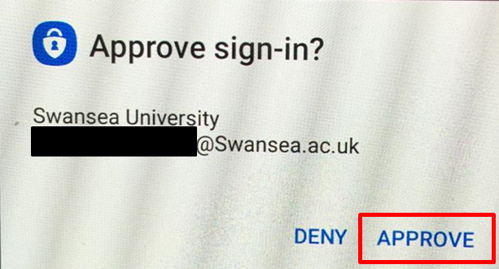
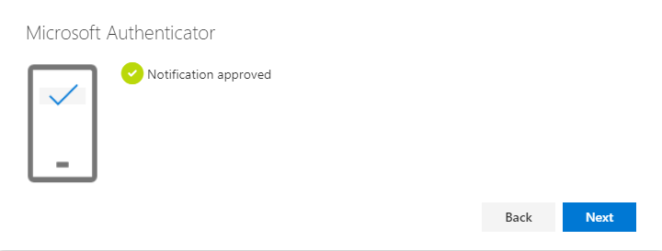
Follow instruction steps.

Slide 10
Notification

Slide 11
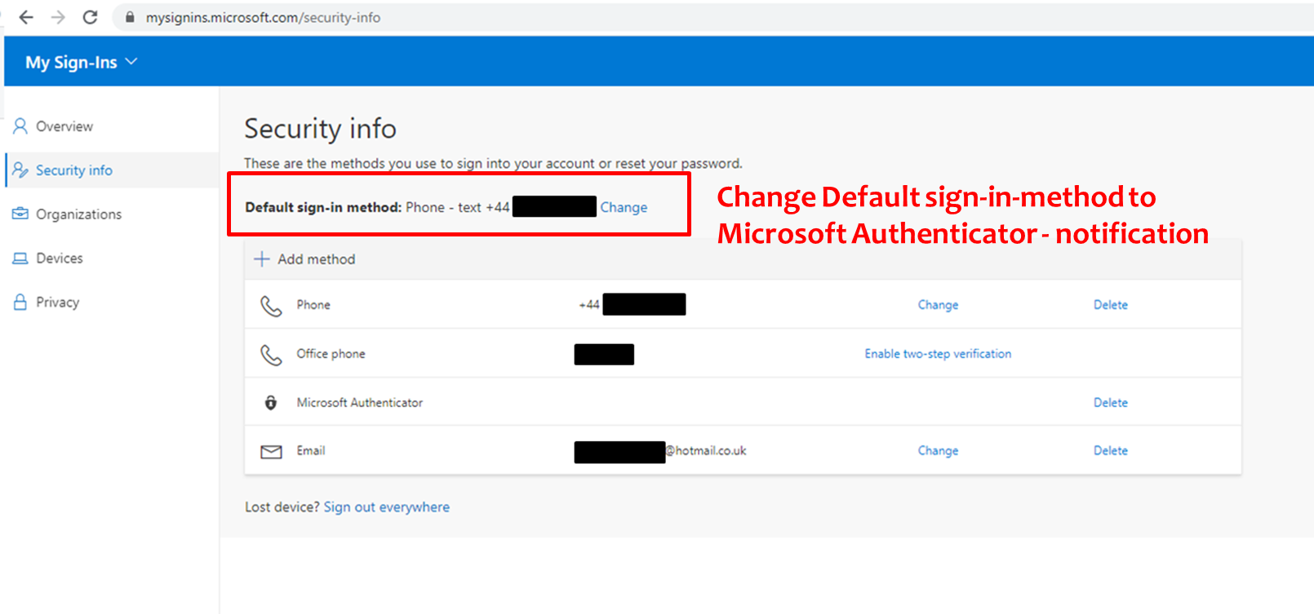

Slide 12
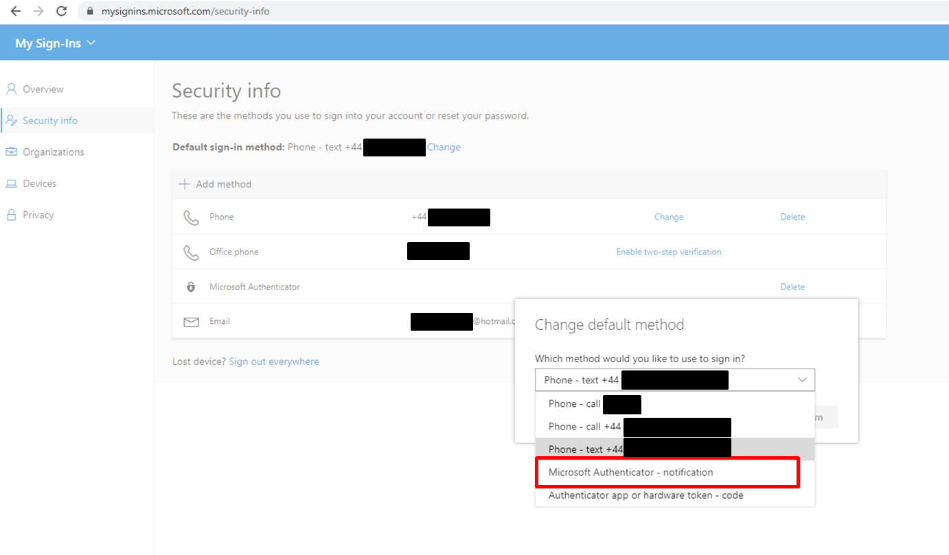

Slide 13
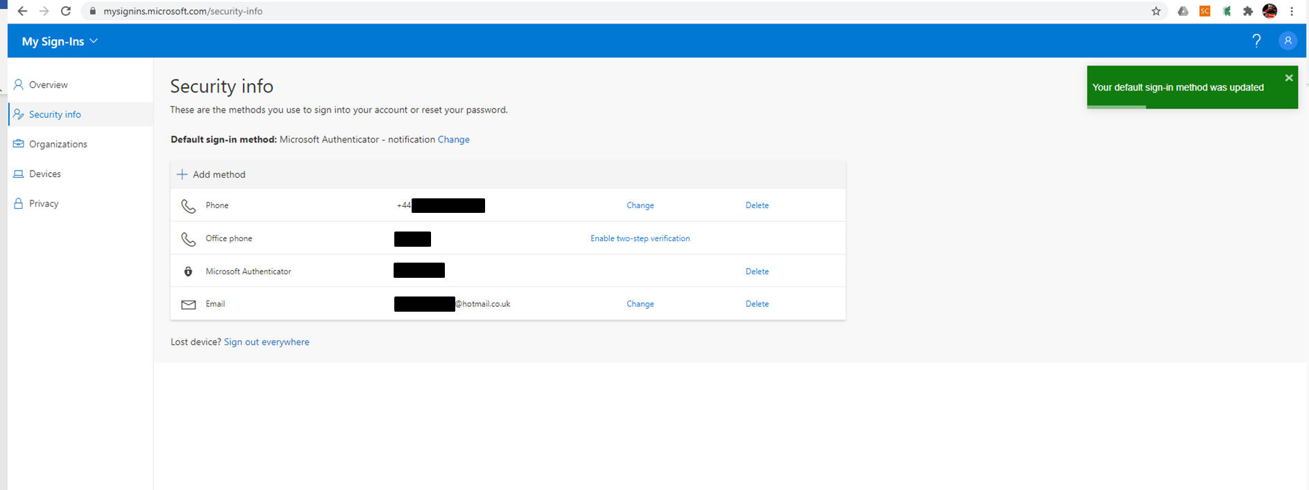

Slide 14
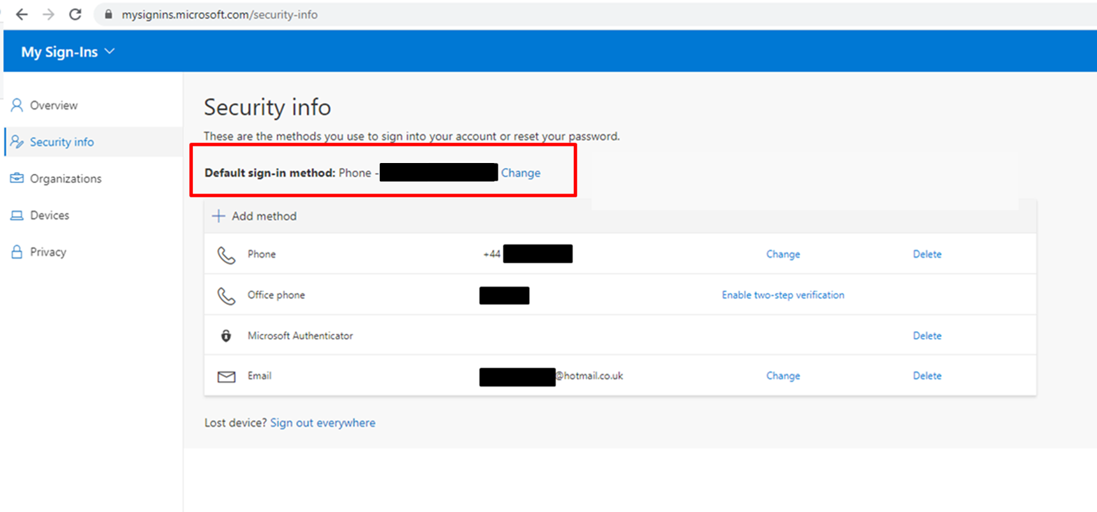
If a smartphone is not available, the only other suitable option for the remote desktop authentication procedure is via phone, NOT by text.

Slide 15
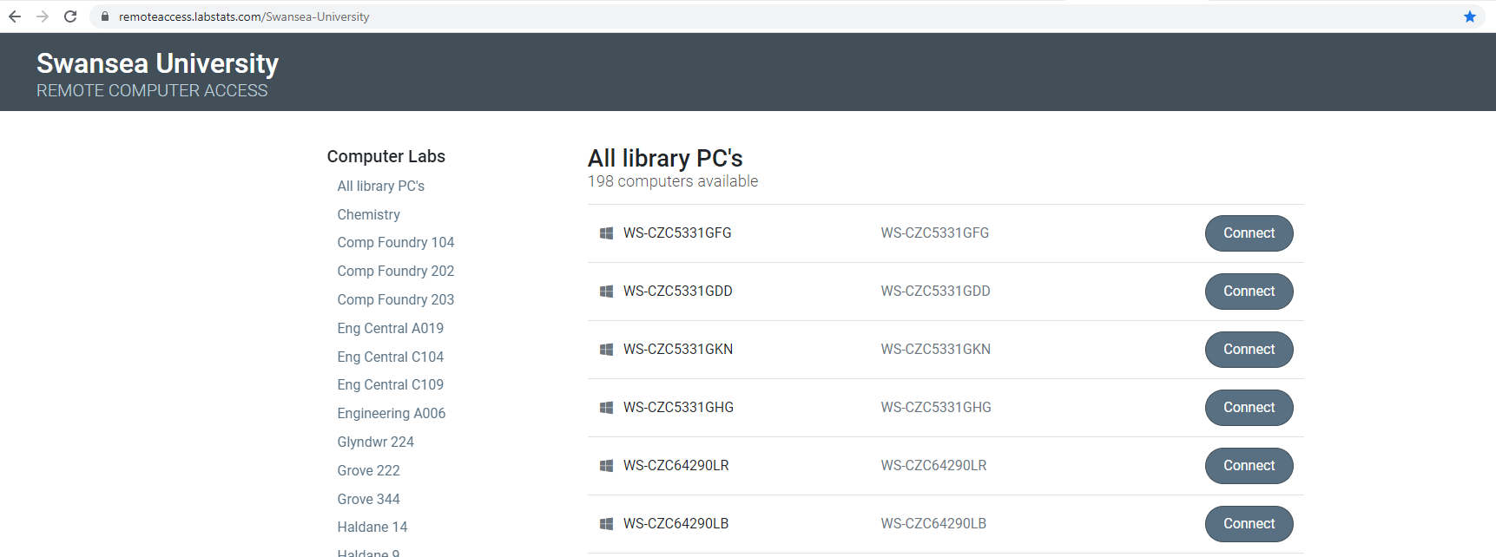
When Connecting to University Computers using the Instructions provided to students, a notification will be generated in the Authentication app. Press ‘Approve’.

